Slide 1
EMPLOYEE MANAGER (Java & SQL)

Slide 2
Overview
Objective: Create a robust system to manage employee data efficiently.
Technologies: Utilizes Java Swing for the interface and SQL for database management.
Core Functions:
Add new employees
Edit employee details
Delete employee records

Slide 3
Benefits and Impact
Centralized Information: All employee data in one accessible location.
Process Automation: Reduces manual tasks, saving time and reducing errors.
Improved Accuracy: Ensures data consistency and reliability.
Enhanced Efficiency: Streamlines HR operations, boosting productivity.
Impact: Boosts organizational effectiveness.

Slide 4
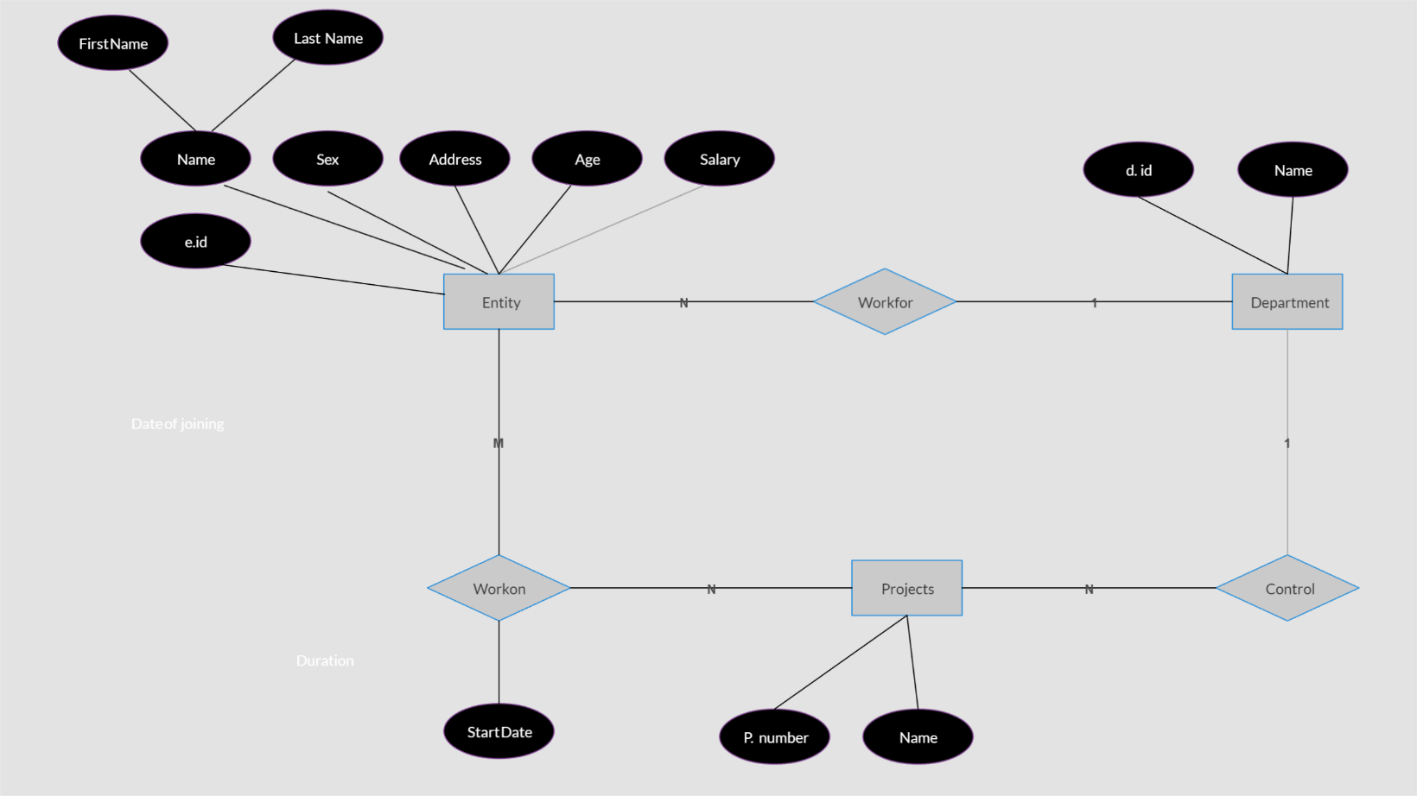
Entity – Relationship Diagram

Slide 5
Frontend Development
The Frontend was developed using the JAVA Swing Framework.
Java Swing is useful when building GUI based systems and programs.
KEY FEATURES:
Efficient Rendering: Smooth and fast interface updates.
Buttons and Menus: Intuitive navigation.
Error Handling: Graceful management of connectivity issues and data errors.

Slide 6
Backend Development
Database: local database name: employeeManager
The Backend is developed using the RDBMS Language “SQL”.

Slide 7
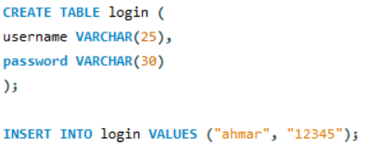
Login Page
This page asks the user for 2 Inputs (username and password).
These details are double checked from the local database and if they match, the login in successful and vice versa.
Default Username: “ahmar”.
Default Password: “12345”.

Slide 8
Home Page
This page consists of all the options including:
Add Employee
View and Update Employee
Delete Employee
These features have embedded SQL queries in the Java Code as well as the local database MySQL.
Some snippets of the code are shown in the next slides:

Slide 9
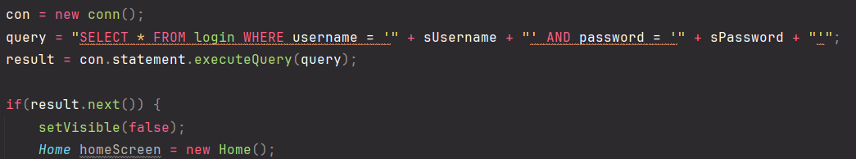
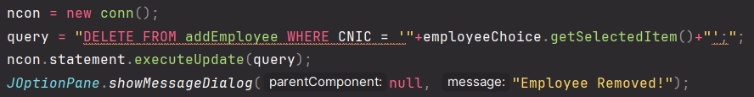
Important SQL Queries Embedded in Java

Slide 10
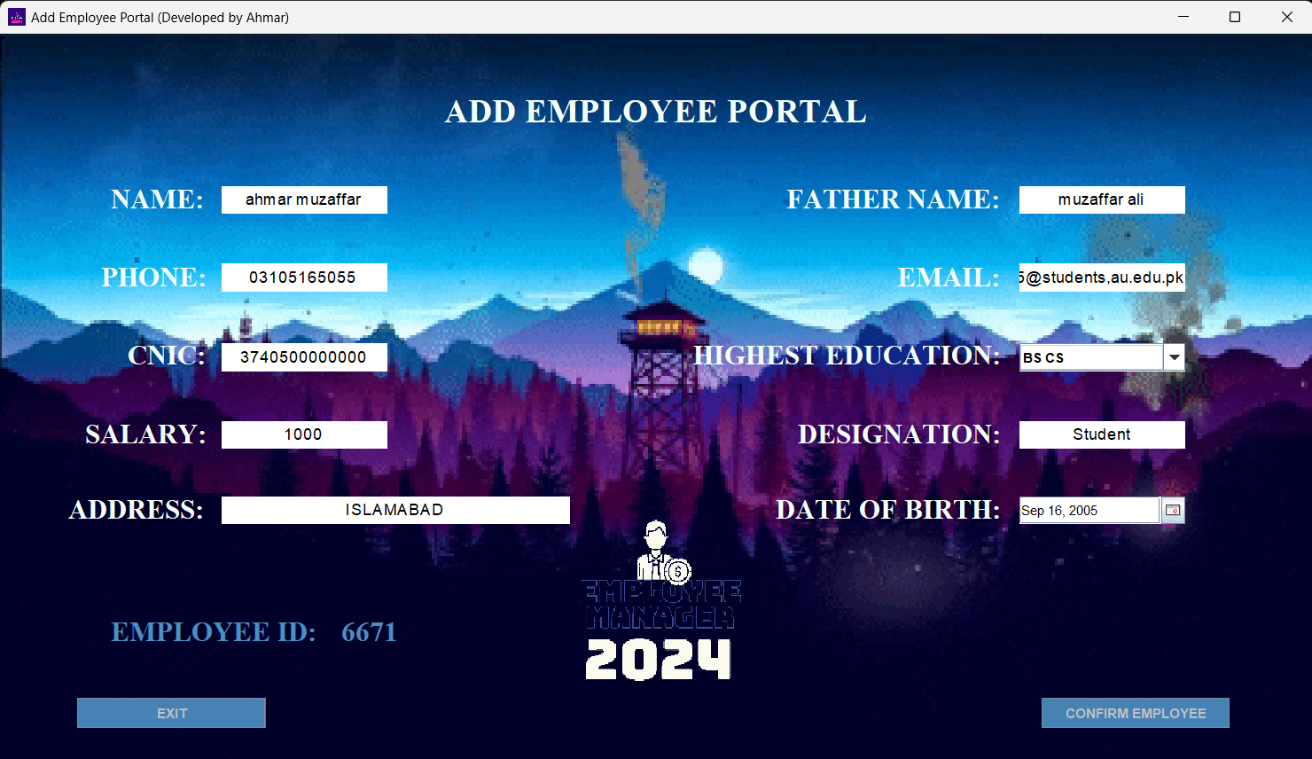
Add Employee
This Page lets the admin add an employee to the local database of the company and all his/her details are stored in the database.
connection = new conn(); query = "INSERT INTO addEmployee VALUES ('"+cnic+"', '"+id+"', '"+name+"', '"+fatherName+"', '"+dateOfBirth+"', '"+edu+"', '"+address+"', '"+phone+"', '"+email+"', '"+designation+"', '"+salary+"');"; System.out.println("SQL Query: " + query); // Print the SQL query connection.statement.executeUpdate(query); JOptionPane.showMessageDialog(null, "Employee Added Successfully!"); setVisible(false);

Slide 11
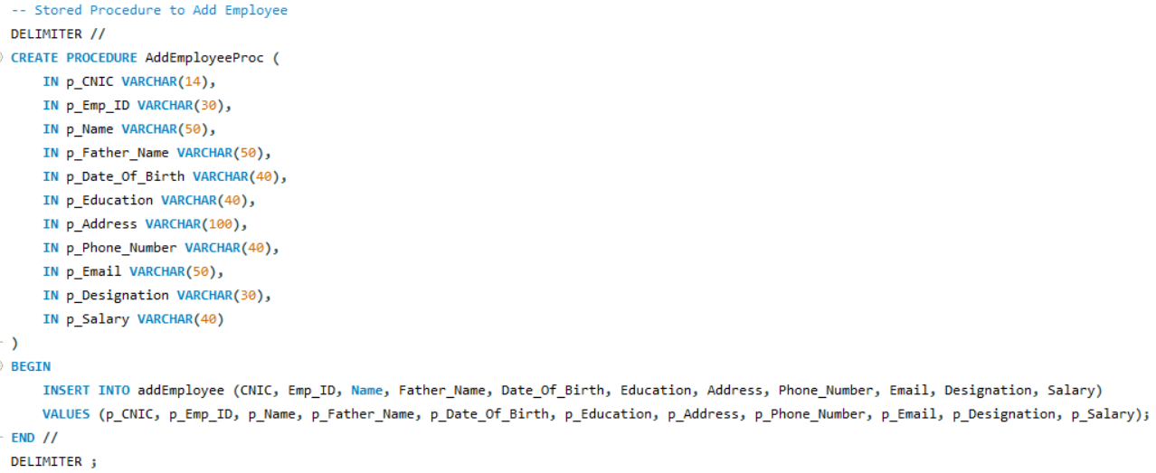
SQL Code on the Backend to Add Employee

Slide 12
View and Update Page
This page lets you View or Update the details of an already existing employee in the local database.
In this scenario, the CNIC ID is the Primary Key for the Employee.
The Employees are searched for via their CNIC ID.

Slide 13
Update Page Specifics
This page Modifies/edits the existing employee details in case of error while entering the details before.
Note that this page only lets you edit some specific values.

Slide 14
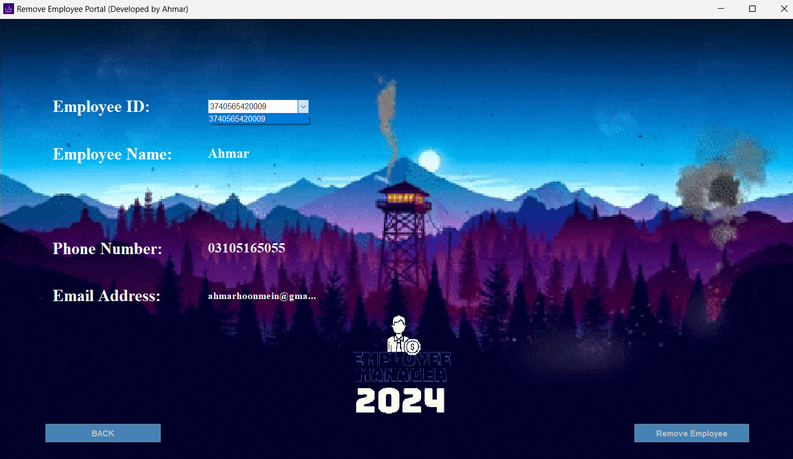
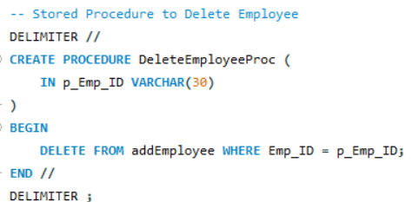
DELETE PAGE
This page lets you search for an Employee and delete his/her details from the local database.

Slide 15
THANK YOU!
Have a good day!

